Slide 1
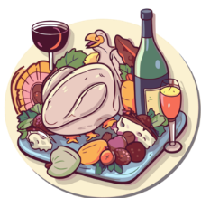

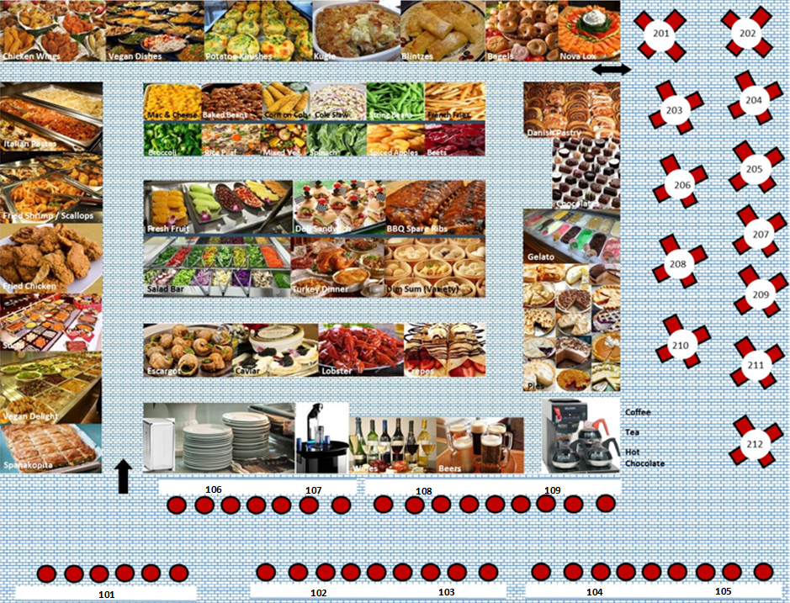
*** NEWLY REMODELED ***
World Interfaith Network (WIN) Café
Choose Your Food * Save To Your Table * Dialogue With New Friends
WELCOME
to Interfaith Awareness Week 2025
and the World Interfaith Network’s Café
where everyone is welcome and
no one goes away hungry.
Choose from over 100 items on the menus below:
copy (ctrl C) and paste (ctrl V) your full meal
and/or snacks onto your table at the bottom!
Save Your Table!
All food items are sugar-free, calorie-free,
gluten-free, kosher and halal.
Café Hours
All Day – Every Day
Before, During & After IAW
https://world-interfaith.com
© COPYRIGHT 2025 WORLD INTERFAITH NETWORK

Slide 2
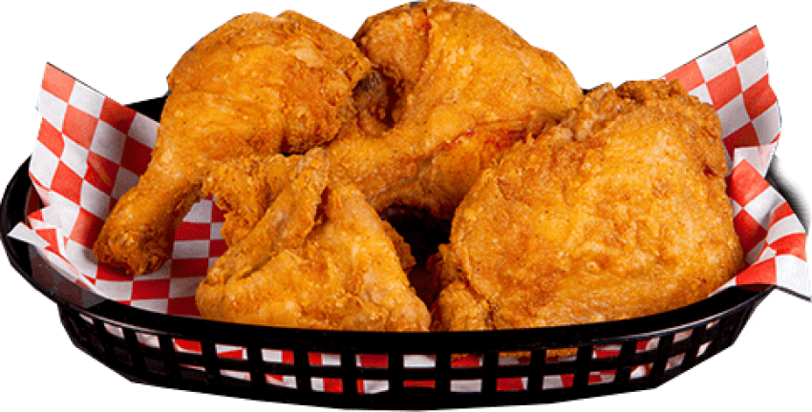

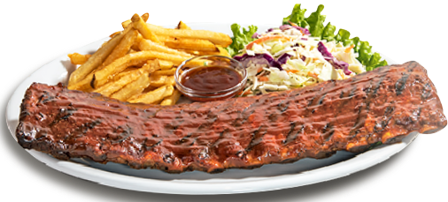
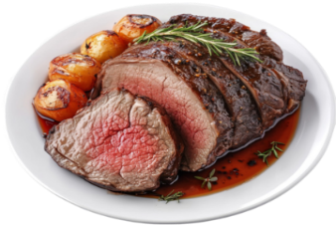
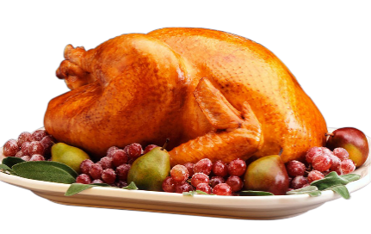
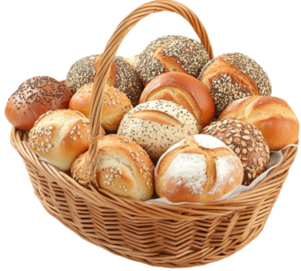
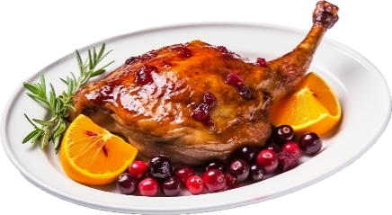
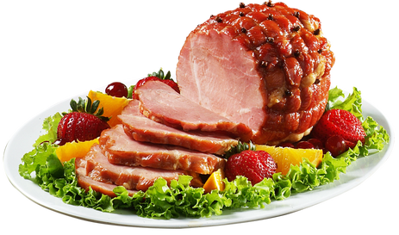
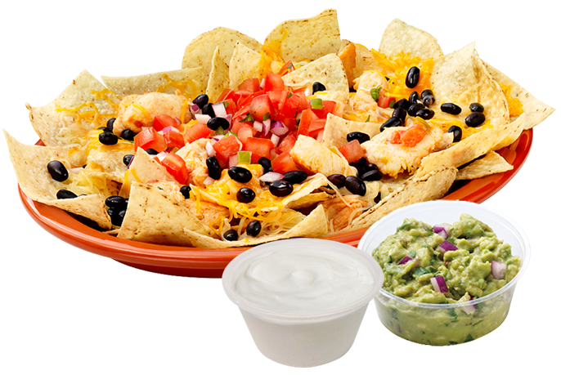
Bar-B-Que Spareribs
Fried Chicken
Boneless Chicken Wings
Main Entrees
Meat Dishes
Select (ctrl C)
Paste onto table below (ctrl V)
Roast Turkey
Prime Rib
Dinner Rolls
Honey Roast Duck
Baked Ham
Nachos

Slide 3

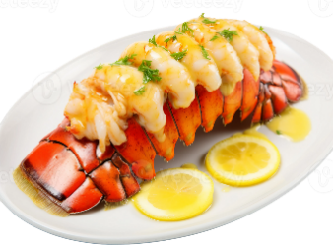
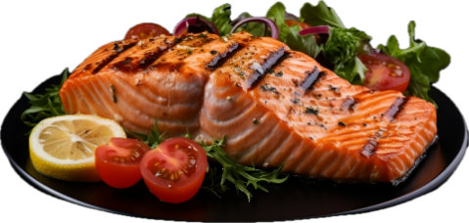
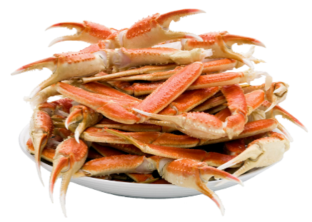
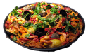
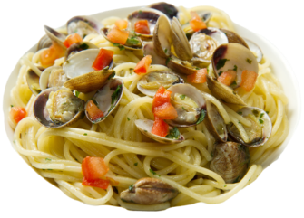
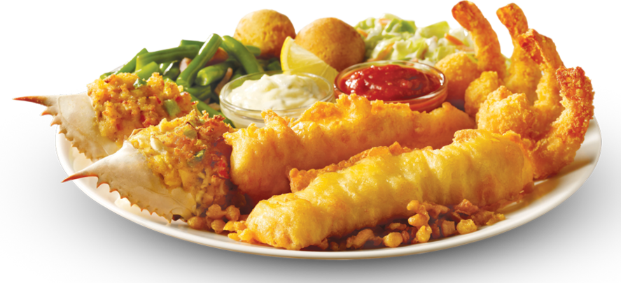

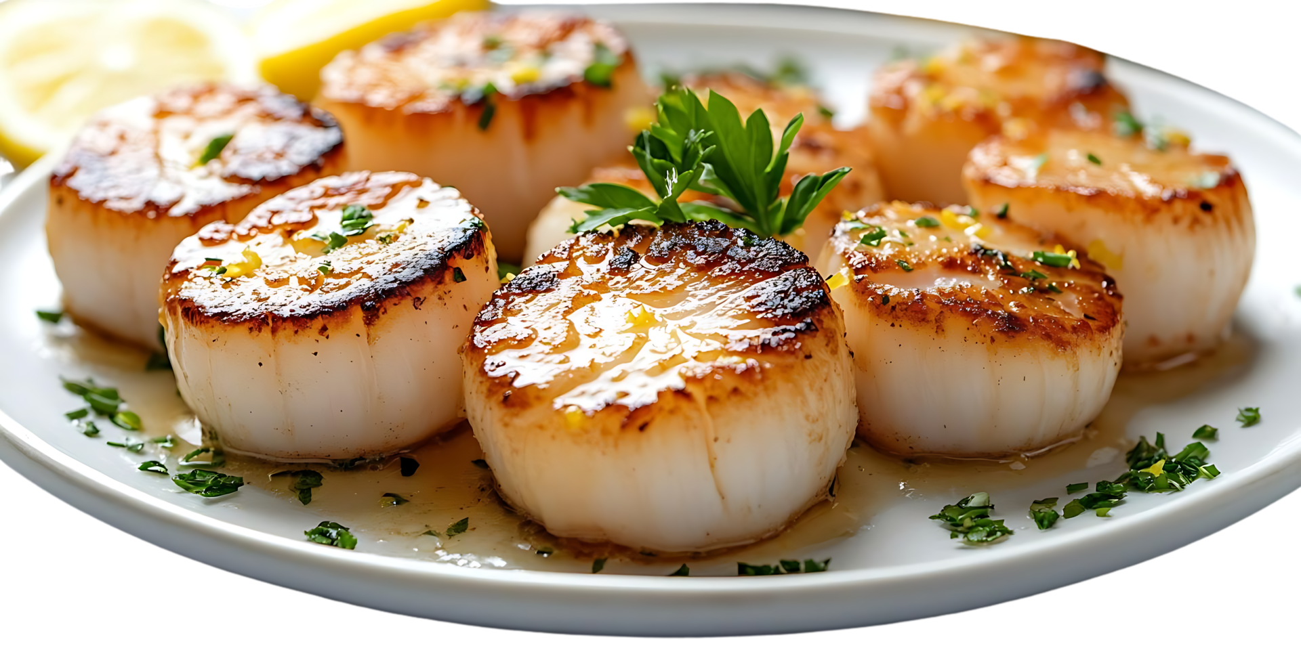
Fried Shrimp
Lobster Tail
Grilled Salmon
Steamed Crab Legs
Main Entrees
Fish Dishes
Select (ctrl C)
Paste onto table below (ctrl V)
Paella
Steamed Clams
Seafood Plate
Shrimp Cocktail
Seared Scallops

Slide 4

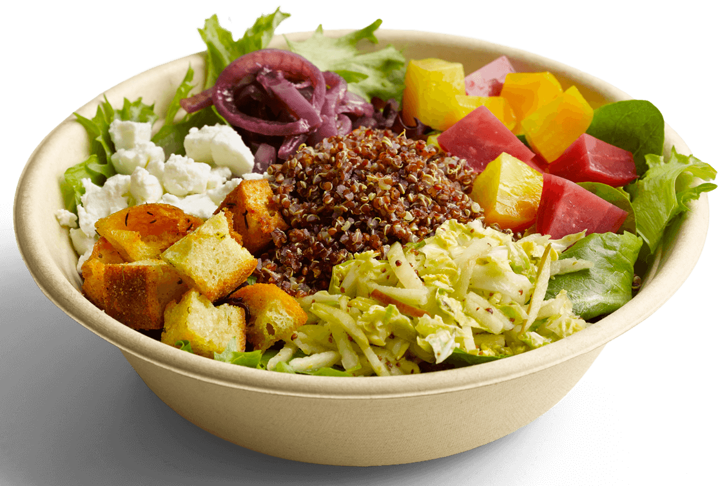
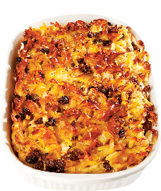
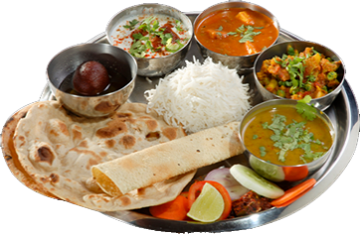
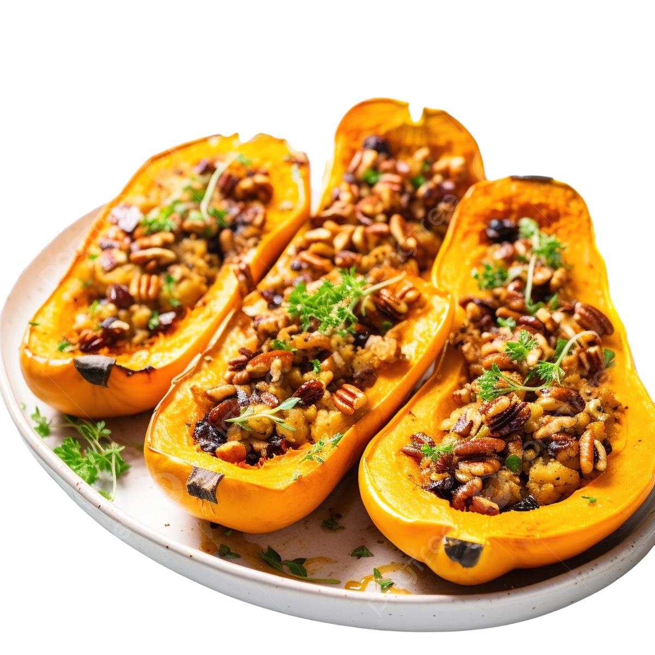
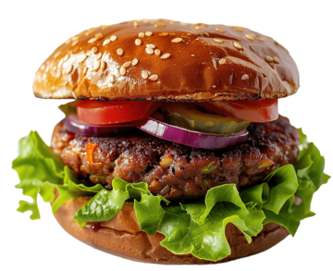
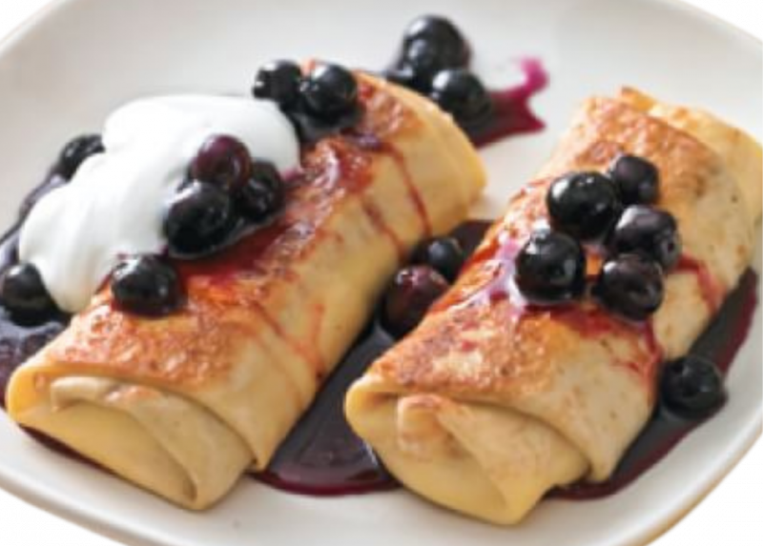

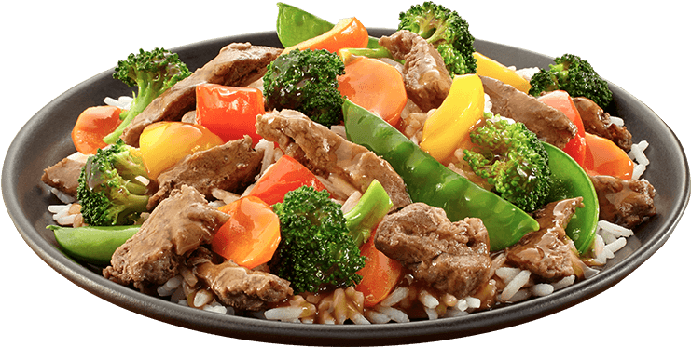
Spanakopita
Vegan Delight
Vegan Meal
Sweet Noodle Kugle
Main Entrees
Vegetarian Dishes
Select (ctrl C)
Paste onto table below (ctrl V)
Vegan Burger
Butternut Squash
Marinated Tofu
Cheese Blintzes
Vegi Stir-Fry

Slide 5
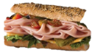


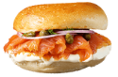
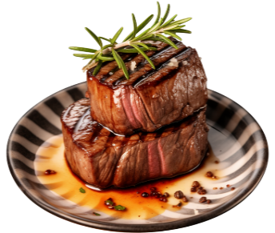
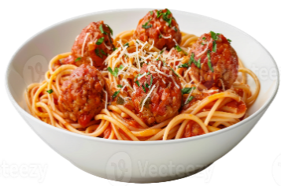
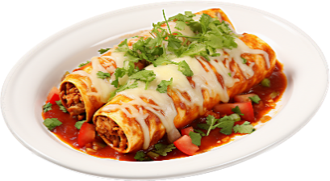
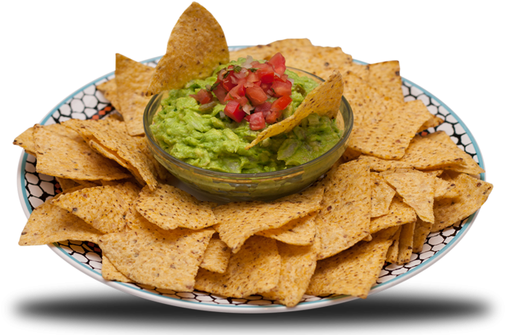
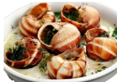


Deli Sandwich
Nova Lox on Bagel
Suchi
Dim Sum
Main Entrees
Specialty Dishes
Select (ctrl C)
Paste onto table below (ctrl V)
Caviar Filet Mignon
Spaghetti & Meatballs
Enchiladas
Guacamole & Chips
Escargot
Roasted Potatoes Au Gratin

Slide 6


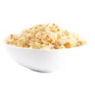


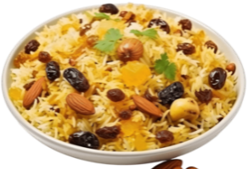
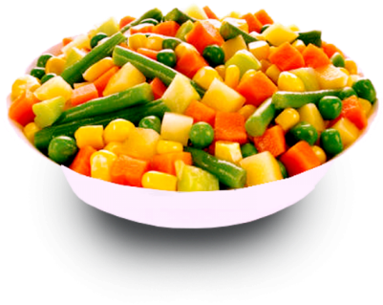

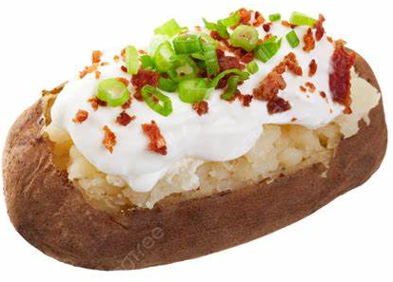
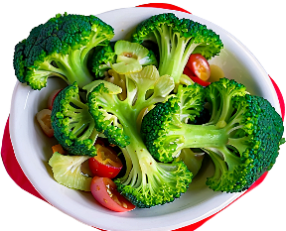

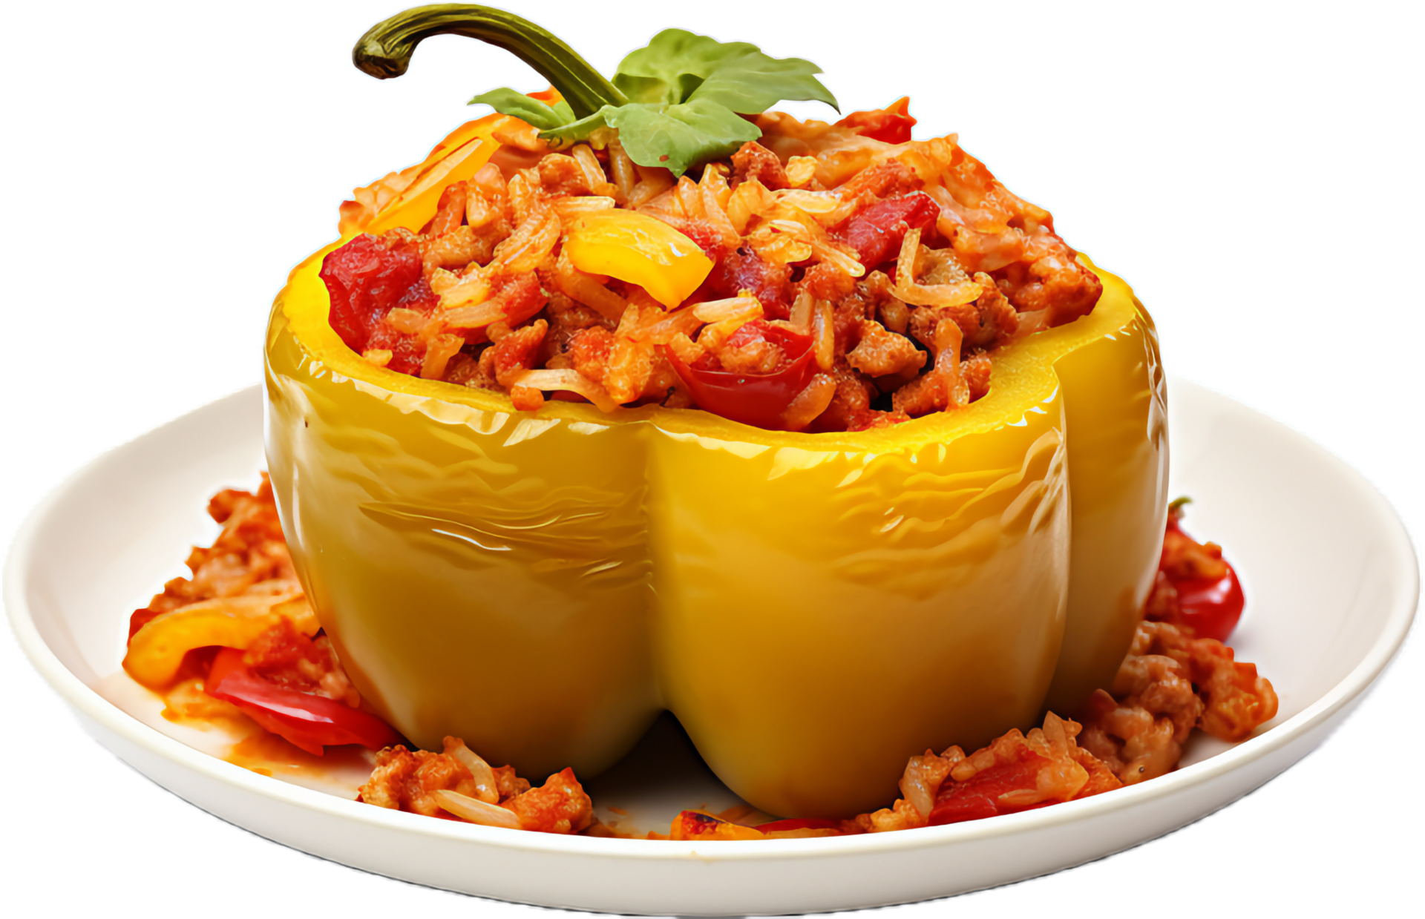
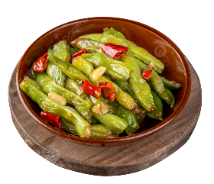
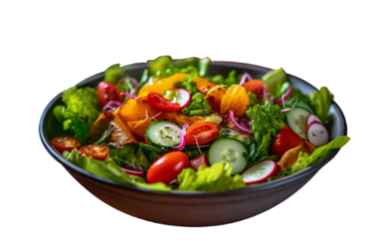
Mac & Cheese
Baked Beans
Corn on the Cob
Cole Slaw
French Fries
Rice Pilaf
Mixed Vegies
Spinach
Broccoli
Loaded Potato
Side Dishes
Select (ctrl C)
Paste onto table below (ctrl V)
Beets
Stuffed Pepper
String Beans
Garden Salad

Slide 7
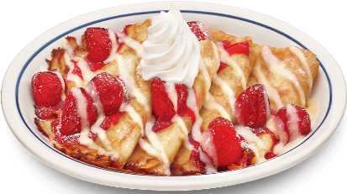








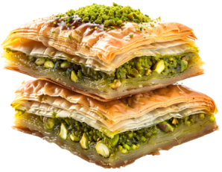

Strawberry Crepes
Fresh Fruit
Freshly Baked Pies
Danish Pastries
Desserts
Select (ctrl C)
Paste onto table below (ctrl V)
Ice Cream Sundae
Gelato
Baklava
Ice Cream Cone
Tiramisu
Assorted Chocolates
Fruit Crepe

Slide 8














Water
Coffee
Herbal Tea
Expresso
Hot Chocolate
Lemonade
Iced Tea
Drinks / Beverages
Select (ctrl C)
Paste onto table below (ctrl V)
Sodas
You Must Be 21+ to Consume Alcoholic Drinks
Milk Shakes
Beer on Tap
Wine
Champagne
Tequilla Shots
Saki

Slide 9



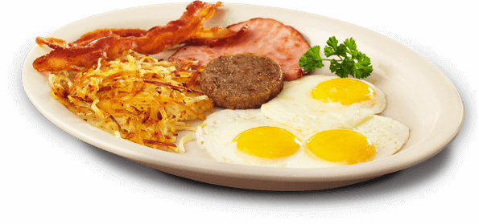
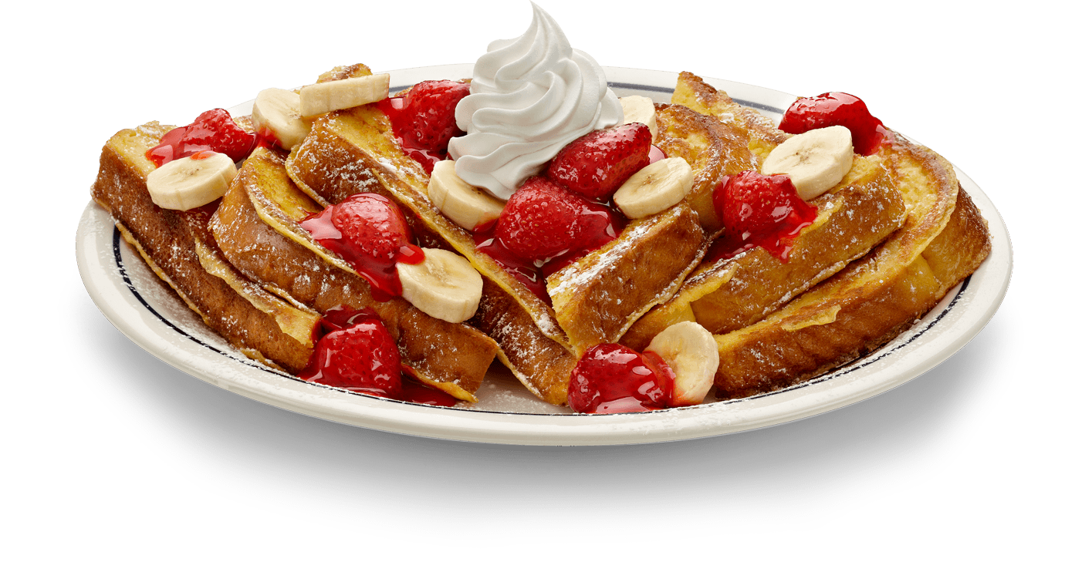

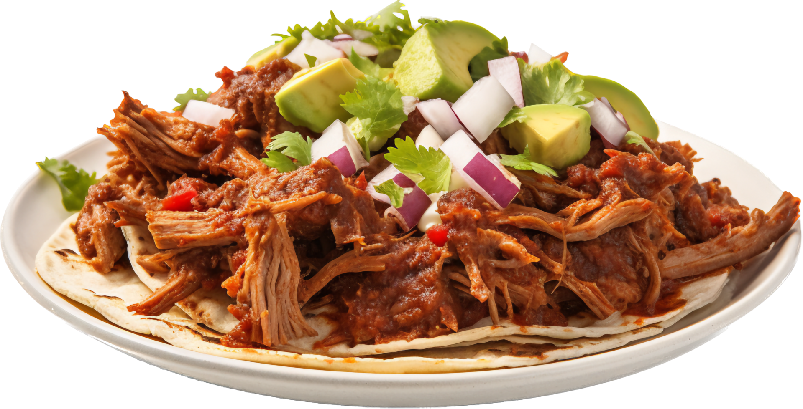





Pancakes
French Toast
Eggs Benedict
Waffles
Egg Combo Plate
24 Hour Breakfast
Select (ctrl C)
Paste onto table below (ctrl V)
Bacon & Eggs
Machaca Plate
Quiche
Sausage & Sweet Potatoes
Donuts
Mimosa
Fresh Fruit Juices

Slide 10

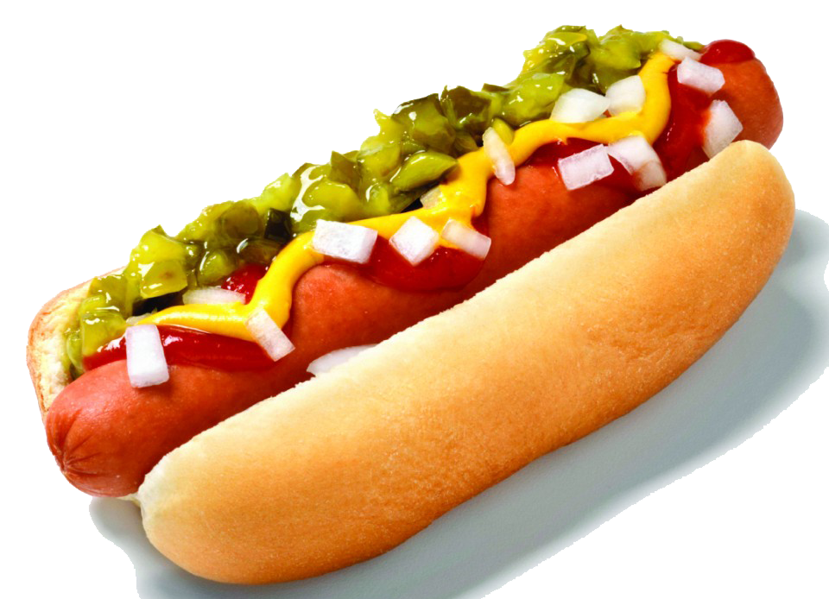

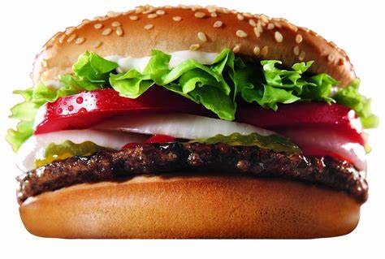
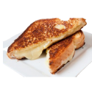
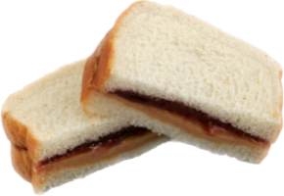
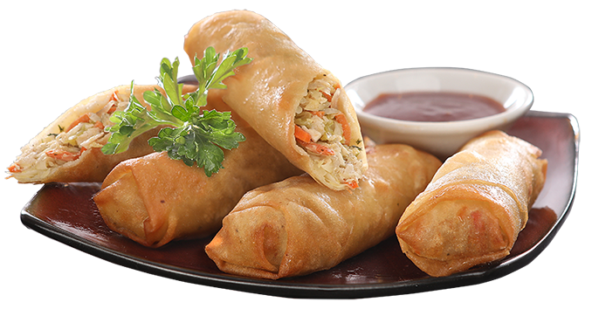

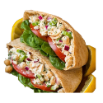








Taco
Hot Dog
Hamburger
Cheeseburger
Grilled Cheese
PB & Jelly
Egg Rolls
Churros
Mixed Nuts
Tuna Salad
Light Menu
Select (ctrl C)
Paste onto table below (ctrl V)
Pizza Slice
S’mores
Mints
Soft Ice Cream
Brownie
Large Cookie
Licorice

Slide 11







World Interfaith Network Café – Interfaith Awareness Week 2025

